Slide 1





ZERO-SHOT LEARNING FOR RARE DISEASE DIAGNOSIS USING TEXTUAL SYMPTOM DESCRIPTIONS

Slide 2


INTRODUCTION
Rare diseases affect a small number of people, but are large in number globally
Most rare diseases lack enough patient data for AI training
Traditional AI needs many labeled examples to learn
Zero-Shot Learning (ZSL) can predict diseases without training on specific examples
ZSL uses textual symptom descriptions to make predictions
Helpful in medical settings where data is limited but decision-making is critical

Slide 3

PROBLEM STATEMENT
Rare diseases often have very few diagnosed cases
Lack of labeled data makes it hard to train AI models
Traditional models cannot recognize diseases they haven’t seen before
Patients face delayed or incorrect diagnoses
Need a method that works without relying on large datasets

Slide 4

OBJECTIVE
To Use Zero-Shot Learning for rare disease diagnosis
To match patient symptoms to disease descriptions
To reduce dependency on large labeled datasets
To support faster and smarter diagnosis
To improve AI accessibility in rare conditions
To improve diagnosis using existing symptom descriptions instead of case data

Slide 5
LITERATURE SURVEY
Title | Author name | Dataset Used | Model used | Metrics | Limitations
Zero-Shot Learning Algorithms for Object Recognition in Medical and Navigation Applications | Sangeeta Nair and Arvind Kumar | Improved Zero-Shot Learning (I-ZSL) Framework, Variational Autoencoders (VAEs), Transformer-based Embeddings, Domain-Adaptive Classifier | The ChestX-ray14 dataset is utilized for medical diagnostics, The Google Landmarks Dataset (GLDv2) is used for navigation tasks. | F1-score, Mean Average Precision (mAP), Classification Accuracy. | Scalability Issues, Dynamic Environments, Semantic Alignment and Scalability, Dependence on Labeled Data
Zero-Shot Learning: Teaching AI to Understand the Unknown | Deekshitha Kosaraju | Discusses the challenge of gathering 'vast amounts of data sets' | Domain Stacked AutoEncoders (DaSAEs) | Accuracy, Recall. | Challenge of domain shift
Text Compression-aided Transformer Encoding | Zuchao Li, Zhuosheng Zhang , Hai Zhao ,Rui Wang, Kehai Chen, Masao Utiyama ,Eiichiro Sumita | Annotated Gigaword corpus, CNN/DailyMail CNN/DM, WMT News Crawl datasets , SQuAD 2.0 , Multi-Genre Natural Language Inference (MNLI) | Transformer encoder, Explicit Text Compression (ETC), Implicit Text Compression (ITC). | ROUGE-1 (R-1), ROUGE-2 (R-2), and ROUGE-L (R-L) , BLEU score, Exact Match (EM) and F1 score for SQuAD 2.0 , Accuracy for RACE. | ETC Joint Training Speed, ITC Performance on Text Compression, Non-autoregressive Decoder Weaknesses, Domain Inconsistency.

Slide 6
LITERATURE SURVEY
Title | Author name | Dataset Used | Model used | Metrics | Limitations
Quantum Text Encoding for Classification Tasks | Aaranyalexander, Dominic Widdows | dataset of 50 actual movie reviews for predicting sentiment. It also mentions previous results on an artificial dataset of 100 short sentences | Amplitude encoded feature map combined with a quantum support vector machine. | An average accuracy of 62% for sentiment prediction | Dataset is considered small, Previous methods achieved perfect accuracy but at the unscalable cost of using a qubit for each word.
BioBERT-based Deep Learning and Merged ChemProt-DrugProt for Enhanced Biomedical Relation Extraction | Bridget T. McInnes, PhD, Jiawei Tang, MS, Darshini Mahendran, PhD, and Mai H. Nguyen, PhD. | ChemProt and DrugProt | BioBERT Model, Fully Connected Top Layer, | Precision, recall, and F1 score. | While the inclusion of the top model enhanced the F1 score, this enhancement was not statistically significant, suggesting that achieving state-of-the-art results does not necessarily require a more complex system
An Analysis On Large Language Models In Healthcare: A Case Study Of Biobert | Shyni Sharaf and V. S. Anoop | MedQA dataset | BioBERT, other LLMs like GPT-3, BERT, RoBERTa, PaLM, Cohere, LaMDA, and Llama | F1 score, Accuracy, Precision, Recall, AUC, C-index | Data Privacy and Security, Bias and Fairness, Lack of Transparency.

Slide 7
LITERATURE SURVEY
Title | Author name | Dataset Used | Model used | Metrics | Limitations
Orphanet – Information, Education And Expert Centres For Rare Diseases | Kovács L., Hegyi E., and Nagyová G. | Activity Of The Expert Centre For Rare Diseases (Rd) | EUCERD | Patient Numbers, Expert Advice Provision, Peer-Reviewed Publication. | t the specific quantitative criteria for what constitutes an 'expert enough' center are not universally defined in the paper but rather left to national discretion, which could lead to variability in standards across different countries.
Development and implementation of effective Web Scraping methods for automated data collection and processing using Python | Ruslan K. Sichkariuk, N.V. Kornilovska, Iryna Lurie, and Maria Voronenko | 'examples of real-world data use cases in various fields such as marketing, economics, and business analysis | BeautifulSoup, Selenium, and Scrapy for data collection and processing | Practical aspects of data collection, processing, and automation. | The risk of site blocking, and proposes algorithms to mitigate this, suggesting that managing site blocking is a continuous challenge in web scraping
Web Scraping for Data Analytics: A BeautifulSoup Implementation | Rabia Latif | Amazon website to collect data, specifically a product's name, price, number of reviews, rate, and link | Python's BeautifulSoup library | speed of execution serves as a key performance metric. | Applying it to specific product names rather than generic ones. Extracting only specific information desired from the resulting products.

Slide 8
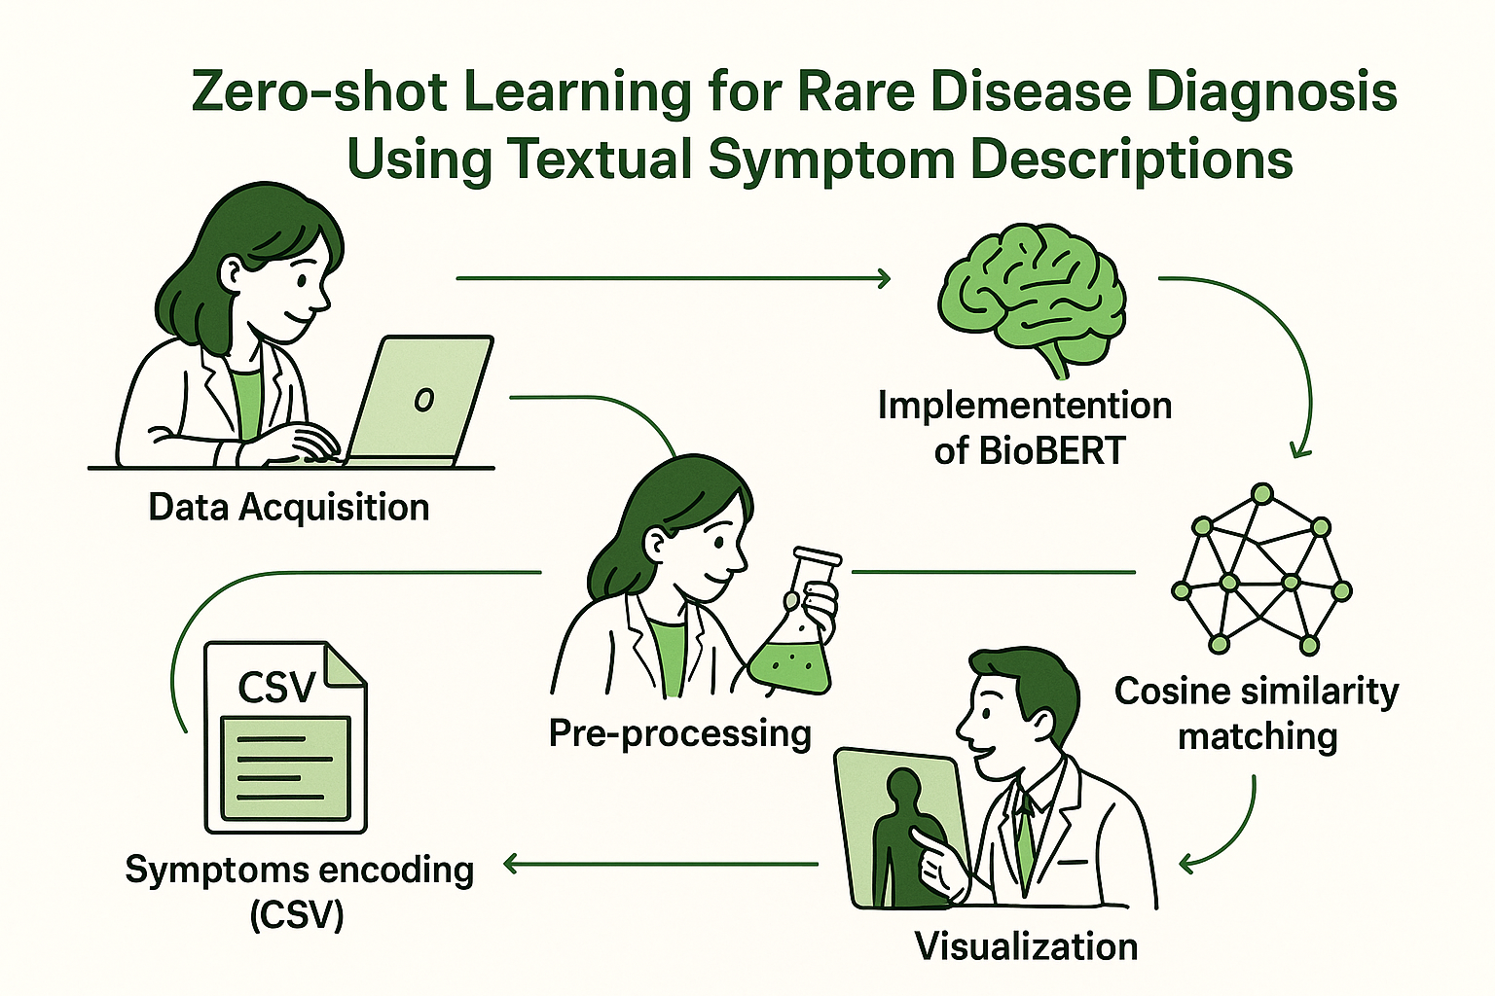
METHODOLOGY

Slide 9
Dataset Description
A custom dataset with over 100 rare diseases was built using the Wikipedia API
For each disease, a short medical summary (2–3 sentences) was collected
All summaries were saved in a CSV file with two columns:
→ Name – the disease name
→ Description – a brief explanation of the disease
These descriptions are used to match with patient symptoms using text-based similarity
The dataset is:
→Lightweight and easy to handle
→Automatically generated and updatable
→Well-suited for semantic matching using models like BioBERT

Slide 10
CONCLUSION
Zero-Shot Learning helps with diagnosing rare diseases even when training data is missing
It works by comparing patient symptom text with disease descriptions
Using BioBERT, the model understands the meaning behind medical terms and matches them accurately
This method makes diagnosis faster, more flexible, and doesn’t rely on large datasets
It’s a useful approach for making medical AI more accessible and reliable, especially for conditions that are often overlooked

Slide 11

THANK YOU

